Slide 1

CREDIT CARD FRAUD DETECTION
TEAM MEMBERS:
RAMAKANTH
NIRVIKA
SAI KIRAN
SRUTHI
EESHANI

Slide 2
Objective: Showcase a comprehensive solution to detect fraudulent credit card transactions using the provided dataset.
Key Question: Can we reliably identify fraudulent transactions while minimizing false positives?
Data description:
Source: Kaggle - Credit Card Fraud Detection Dataset
Overview:
Total Transactions: 284,807
Fraudulent Transactions: 492 (~0.17%)
Features: 30 numerical features, including Time, Amount, and 28 anonymized PCA components (V1-V28)
Target Variable: Class, 1 for fraudulent transactions, 0 otherwise
Key Characteristics:
Highly imbalanced dataset
Features are scaled to ensure privacy

Slide 3
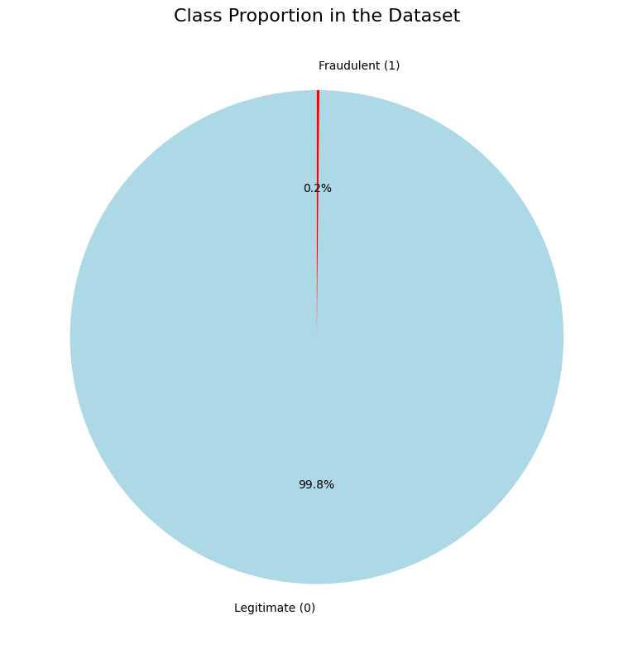
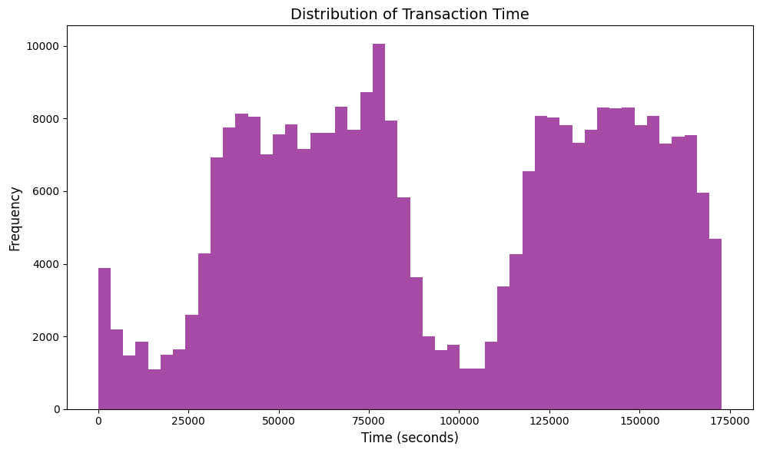
Exploratory Data Analysis (EDA)
Class Distribution: Extreme imbalance between legitimate The histogram shows the distribution of transaction times,
and fraudulent transactions. highlighting activity patterns across the dataset.

Slide 4
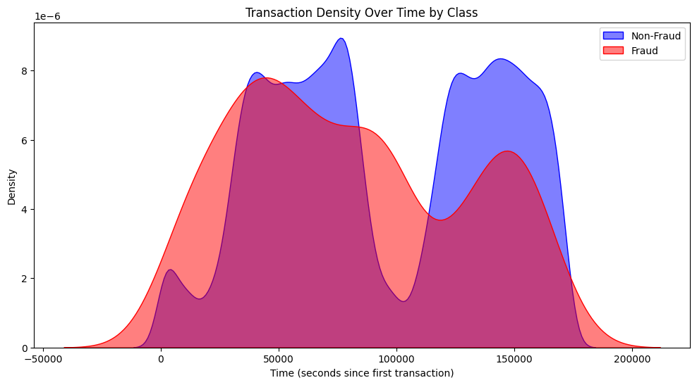
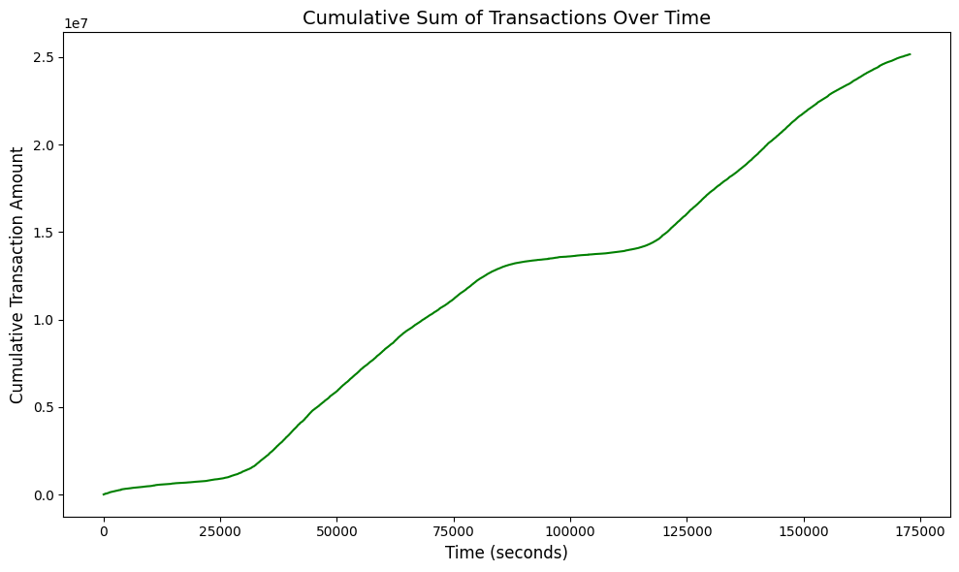
The density plot compares transaction times for fraudulent and The plot shows the cumulative transaction amount over
non-fraudulent transactions, revealing overlapping activity patterns. time, reflecting the overall transaction growth.

Slide 5
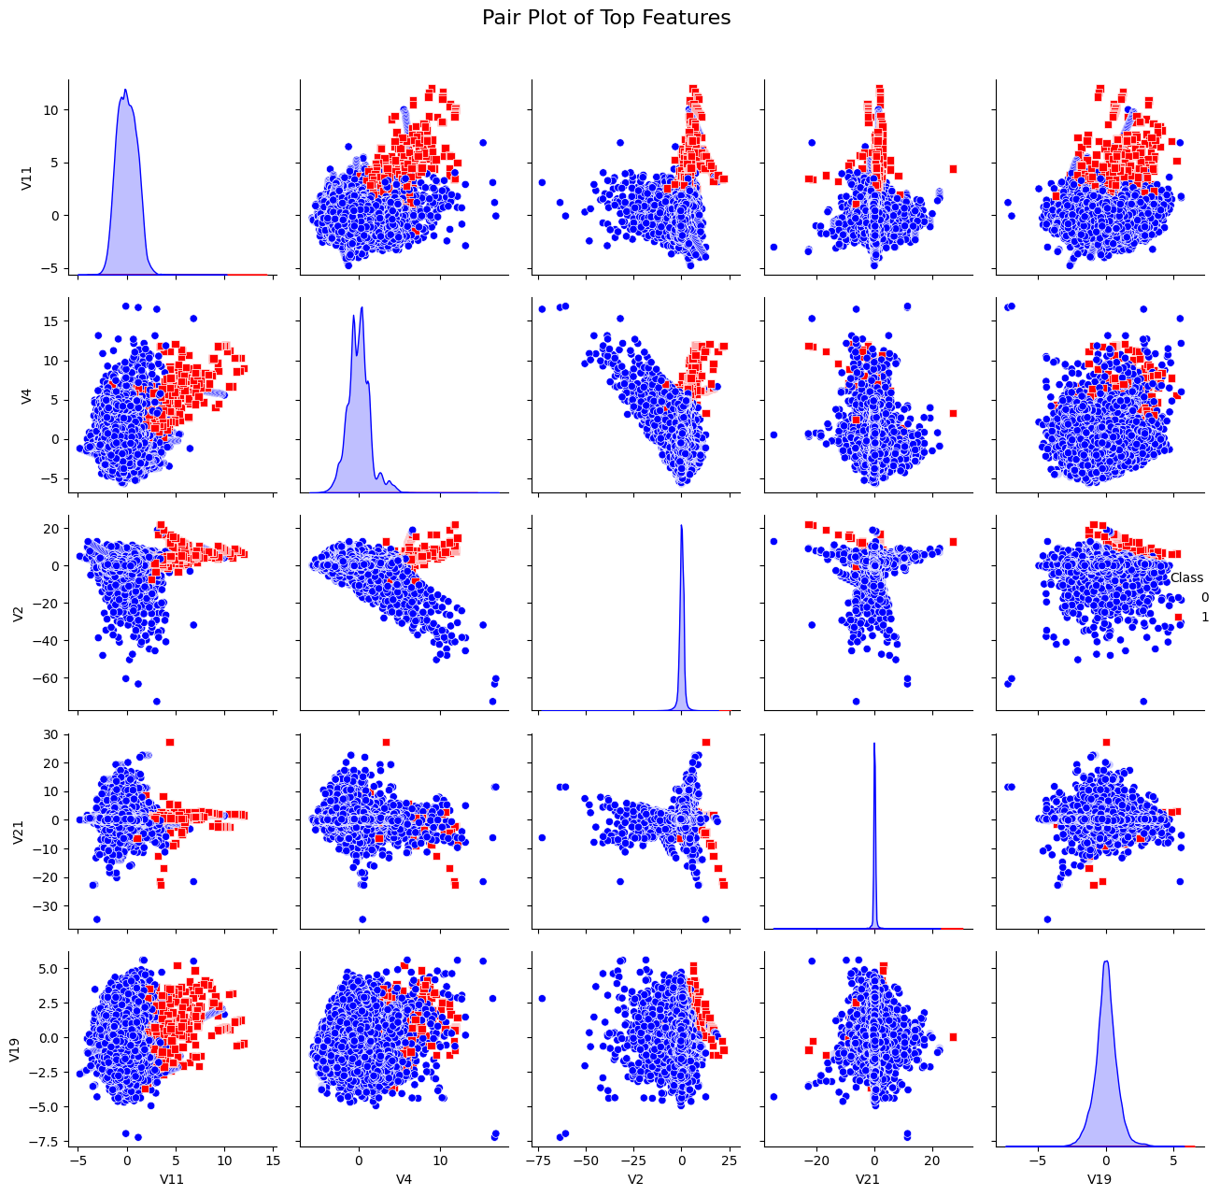
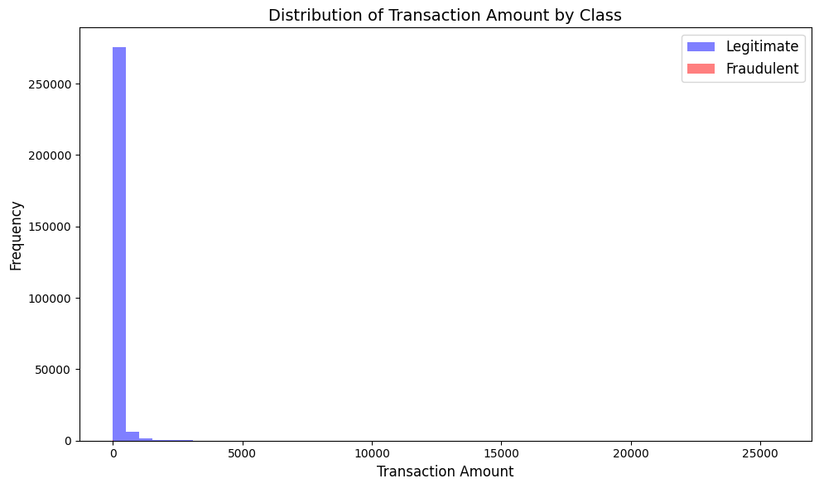
The pair plot visualizes relationships between top features, The histogram compares the distribution of transaction
highlighting separability between fraud and non-fraud classes. amounts for legitimate and fraudulent transactions.

Slide 6
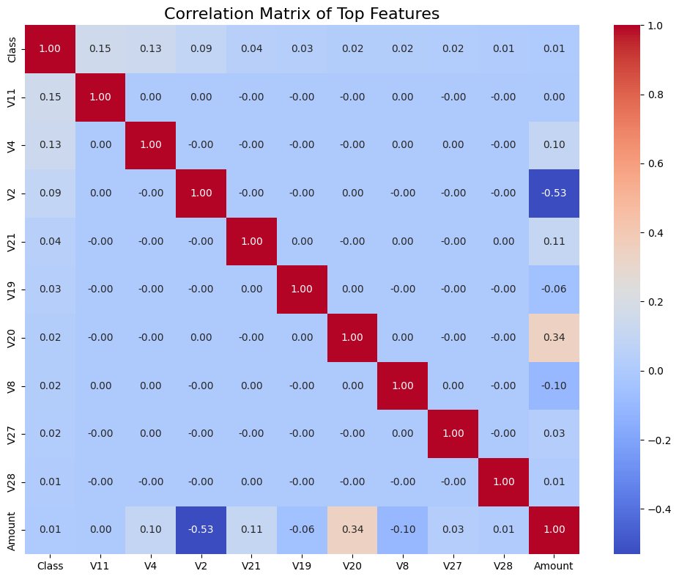
The heatmap displays the correlation matrix for top features, showing relationships between them and the target variable.

Slide 7
SMOTE
SMOTE (Synthetic Minority Over-sampling Technique)
Why SMOTE?
Addresses class imbalance by generating synthetic samples for the minority class
How It Works:
Interpolates between existing minority class samples and their nearest neighbors.
Avoids overfitting caused by simple duplication.
Impact in Fraud Detection:
Balanced the dataset, improving recall and F1-score for fraud cases.
Enhanced the model's ability to detect rare fraudulent transactions.

Slide 8
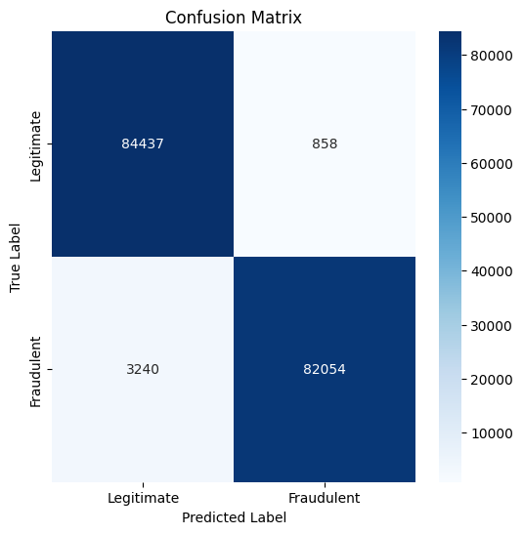
MODELS TRAINED
1. Baseline Model: Logistic Regression
Class Weight: Balanced (Handles Imbalanced Classes)
Performance:
Precision: 0.96 (Class 0), 0.99 (Class 1)
Recall: 0.99 (Class 0), 0.96 (Class 1)
F1-Score: 0.98 for both classes
Accuracy: 98%
Confusion Matrix:
Legitimate (Class 0): 84437 TP, 858 FN
Fraudulent (Class 1): 82054 TP, 3240 FN
Key Insights:
Class Imbalance Handling: Achieved with class_weight='balanced'.
Performance Consistency: Grid Search, Random Search, and Manual Tuning
yield no significant improvement over Baseline.
Best Model Parameters: C=0.1, penalty='l1', solver='liblinear'.
Efficiency: Hyperparameter tuning showed minimal impact due to strong baseline performance.

Slide 9
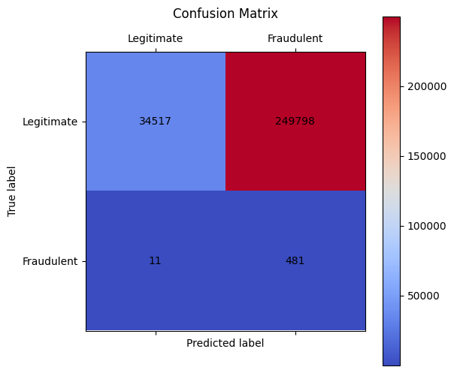
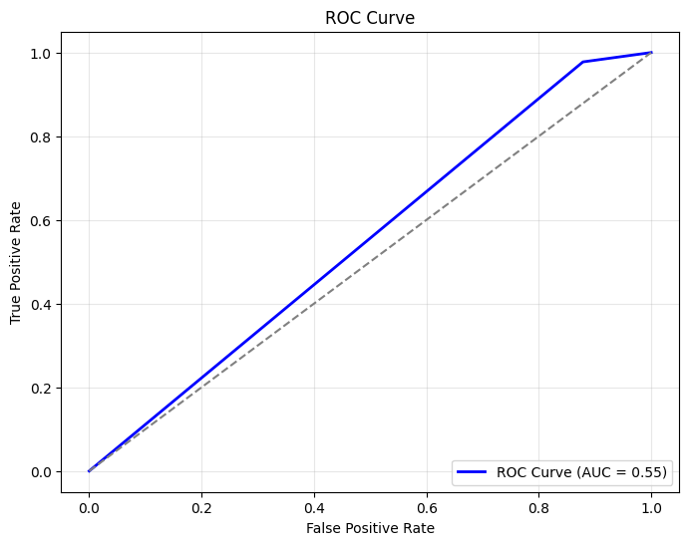
2. DBSCAN (Density-Based Spatial Clustering of Applications with Noise)
DBSCAN Parameters:
eps = 0.2: Max distance between points in a cluster.
min_samples = 3: Minimum points needed to form a cluster.
Model Outcome:
Precision (Legitimate): 1.00, Recall (Legitimate): 0.12,
Precision (Fraudulent): 0.00, Recall (Fraudulent): 0.98
F1-Score: 0.22 for Legitimate, 0.00 for Fraudulent
Accuracy: 0.12, indicating poor overall performance due to high
false positives.
Confusion Matrix:
High False Positives: 249,798 legitimate transactions classified as fraud.
Low True Positives: Only 481 fraudulent transactions correctly classified.

Slide 10
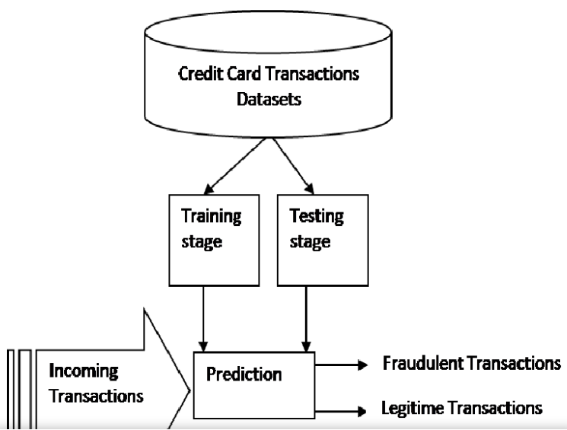
3. Isolation Forest
Model Parameters:
n_estimators: Number of trees in the Isolation Forest model. Values tuned: [50, 100, 150].
contamination: Expected proportion of anomalies in the dataset. Values tuned: [0.001, 0.005, 0.01].
max_samples: Proportion of the dataset to sample for training each tree. Values tuned: [0.8, 0.9, 1.0].
bootstrap: Whether samples are drawn with replacement. Values tuned: [True, False].
random_state: Fixed at 42 for reproducibility.
Evaluation Metrics:
Precision:
Normal (0): 1.00
Anomalies (1): 0.34
Recall:
Normal (0): 0.99
Anomalies (1): 0.86
F1-Score:
Normal (0): 1.00
Anomalies (1): 0.49
Accuracy: 99%

Slide 11
Hyperparameter Tuning:
Explored combinations of n_estimators, contamination, max_samples, and bootstrap to find the best model.
Evaluated models using the F1 score on labeled data (y).
Model Training:
Trained Isolation Forest models on scaled data (X_scaled) with each parameter combination.
Predicted anomalies as -1 (anomaly) and 1 (normal).
Model Selection:
Selected the best-performing model based on the highest F1 score.
Evaluation of Best Model:
Computed classification metrics such as precision, recall, F1-score, and confusion matrix on the labeled dataset.
Anomaly Score Analysis:
Visualized the distribution of anomaly scores using a histogram to understand the model's decision function.

Slide 12
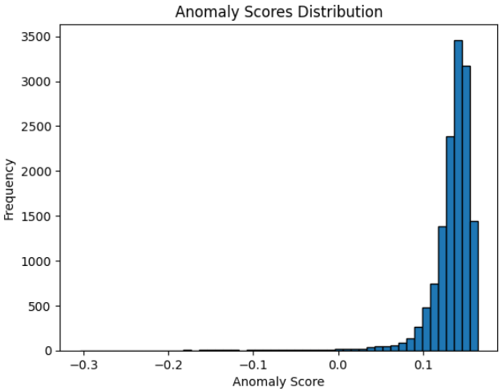
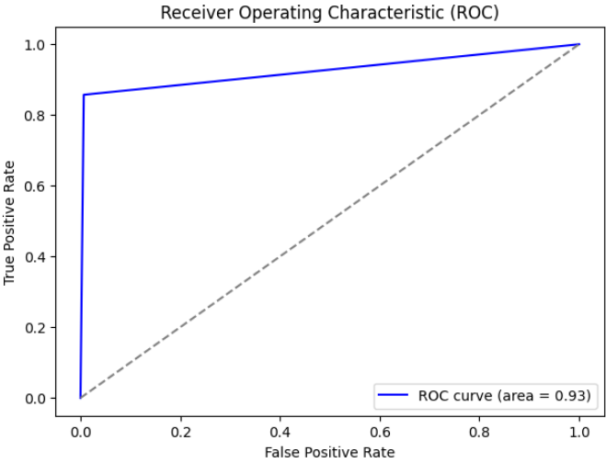
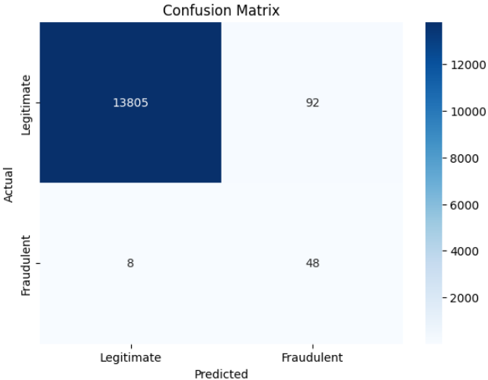
PLOTS

Slide 13
4. Random Forest
Model Parameters:
n_estimators: 100 (number of trees in the forest)
random_state: 42 (for reproducibility)
Steps Performed:
Model Initialization:
Created a RandomForestClassifier with 100 trees and set a fixed random seed for consistent results.
Model Training:
Trained the model on the training dataset (X_train, y_train).
Predictions:
Made predictions on the test dataset (X_test) using:
Class predictions (y_pred): Binary outputs for each sample.
Probabilities (y_prob): Likelihood of belonging to the positive class.
Evaluation:
Assessed model performance using:
Classification Report: Precision, recall, F1-score, and support for each class.
Confusion Matrix: True positives, true negatives, false positives, and false negatives.
Accuracy Score: Overall proportion of correctly predicted samples.

Slide 14
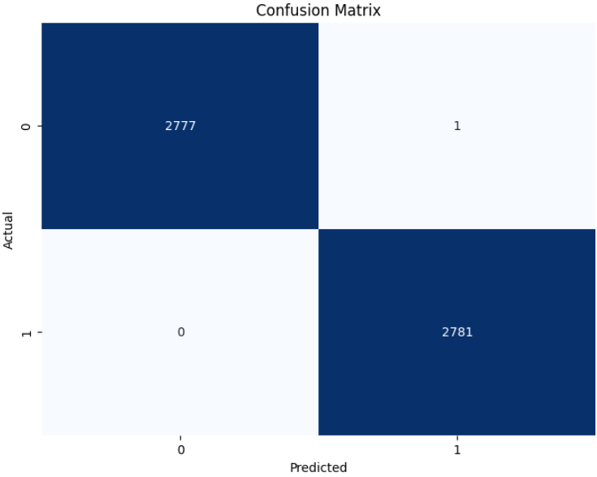
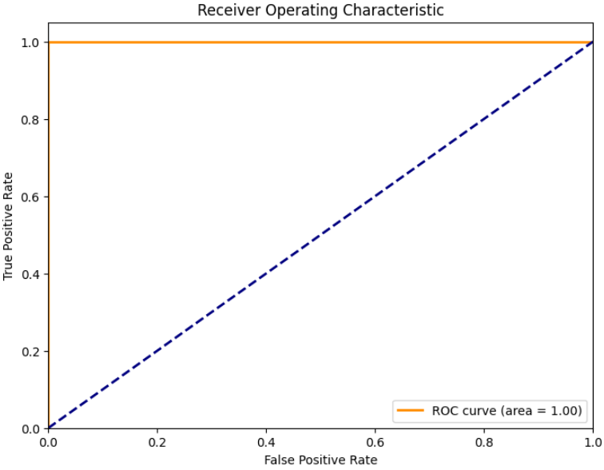
Performance Metrics:
Precision, Recall, F1-Score (Both Classes): 100%
Overall Accuracy: 100%

Slide 15
5. Autoencoder
Autoencoder for Anomaly Detection"
What is an Autoencoder?
Unsupervised neural network for reconstruction.
Higher reconstruction loss → Likely an anomaly.
Model Parameters:
Hidden Layers: [64 → 32 → 16 → 8 → 16 → 32 → 64].
Latent Space (Bottleneck): Size = 8.
Loss Function: Mean Squared Error (MSE).
Optimizer: Adam.
Epochs: 50.
Batch Size: 32.

Slide 16
Hyperparameter Tuning:
Tuned Parameters:
Hidden Layers: [128-64-32-8], [64-32-16-8].
Learning Rate: [0.001, 0.0005].
Batch Size: [32, 64].
Epochs: [50, 100].
Strategy: Grid Search to minimize reconstruction loss on validation data.
Model Training:
Scaled data using MinMaxScaler.
Trained on normal data (unsupervised).
Early stopping to prevent overfitting.
Model Selection:
Best Model:
Hidden Layers: [64 → 32 → 16 → 8].
Epochs: 50.
Selection based on lowest validation reconstruction loss.

Slide 17
Evaluation Metrics:
Precision:
Normal (0): 1.00, Anomalies (1): 0.42.
Recall:
Normal (0): 0.98, Anomalies (1): 0.83.
F1-Score:
Normal (0): 0.99, Anomalies (1): 0.56.
Accuracy: 98.7%.
Anomaly Score Analysis:
Reconstruction Loss:
Normal Data → Low loss.
Anomalies → High loss.
Threshold Selection:
Optimized to balance recall and precision.
Visuals:
Histogram of Reconstruction Loss:
Highlight threshold for anomalies.
Confusion Matrix showing model performance.

Slide 18
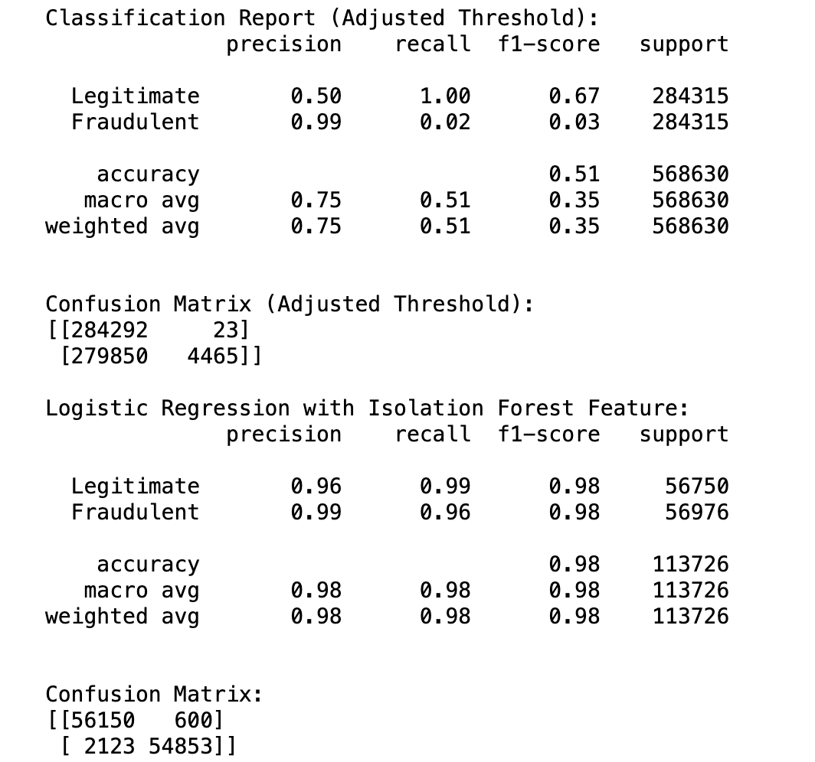
Best model : Logistic Regression with Isolation Forest Features
Combines Isolation Forest for anomaly detection and Logistic Regression for classification.
Handles class imbalance effectively by leveraging anomaly scores as new features.
Why Choose Logistic Regression with Isolation Forest?
Key Criterion: Recall
High recall for both Legitimate (0.99) and Fraudulent (0.96) transactions, minimizing missed fraudulent cases (False Negatives), crucial for fraud detection.
Accuracy:
This model achieves 98% accuracy, significantly outperforming others and demonstrating greater reliability overall.
Balanced Performance:
High precision and recall for both classes lead to better overall performance and reduced misclassification of fraudulent transactions.

Slide 19
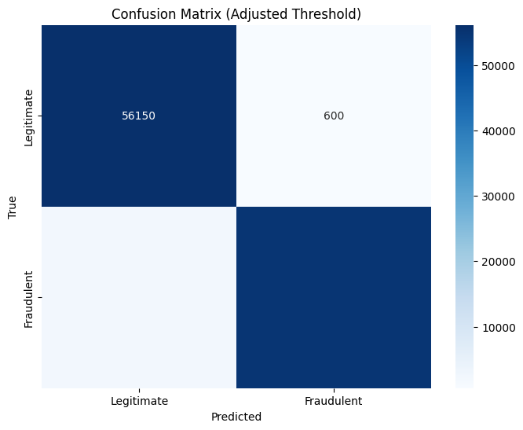
Performance Evaluation
True Positives (Legitimate Transactions):
Adjusted Threshold: 284,292
Logistic Regression + Isolation Forest: 56,150 The Adjusted Threshold detects more legitimate transactions, but with lower recall for fraudulent transactions.
False Negatives (Missed Fraudulent Transactions):
Adjusted Threshold: 279,850
Logistic Regression + Isolation Forest: 2,123 The Logistic Regression + Isolation Forest model misses fewer fraudulent transactions, crucial for fraud detection.
True Negatives (Fraudulent Transactions Correctly Identified):
Adjusted Threshold: 4,465
Logistic Regression + Isolation Forest: 54,853 The Logistic Regression + Isolation Forest model better identifies fraudulent transactions.

Slide 20
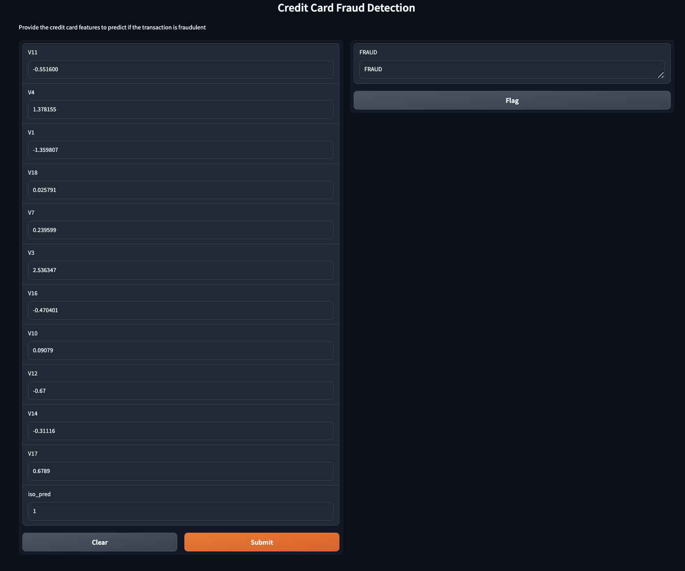
Deployment
Deployed the Logistic Regression with Isolation Forest model for fraud detection using Gradio for interactive prediction.
We utilized the top 10 highly correlated features, such as V4, V1, V18, V7, V3, V16, V10, V12, V14, and V17, which were already transformed using PCA for dimensionality reduction, and and anomaly scores as inputs for the fraud detection model to protect user identities and sensitive data.
Outputs "Fraudulent" or "Legitimate" based on the model’s prediction.
Model is loaded with joblib, and Gradio manages the interface and deployment for real-time fraud detection.

Slide 21
Alternative Approaches:
Explore ensemble techniques like stacking
Utilize cost-sensitive learning methods
Further Analysis:
Examine temporal patterns in fraud occurrences
Integrate external data sources to improve feature richness
Next Steps:
Monitor performance and adapt to evolving fraud tactics
Explainability: Leverage SHAP or LIME for model interpretability.
Seasonal Analysis: Investigate temporal and seasonal fraud patterns.
Real-time Detection: Develop a real-time fraud detection system.
Summary:
Effective fraud detection requires advanced techniques to handle imbalanced and complex data
The proposed solution demonstrates strong performance but highlights areas for further improvement

Slide 22
Thank You

